Slide 1
Text Mining & NLP Common TM Visuals
Ted Kwartler

Slide 2
Getting a Word Frequency Matrix
beerFreq<-colSums(beerDTMm)
beerFreq<-data.frame(word=names(beerFreq),frequency=beerFreq)
Document Term Matrix
Word Frequency Matrix
 | Term1 | Term2 | Term3 | … | Term_n
Tweet1 | 0 | 1 | 1 | 0 | 0
Tweet2 | 0 | 1 | 0 | 0 | 0
Tweet3 | 0 | 0 | 0 | 3 | 0
… | 0 | 0 | 0 | 1 | 1
Tweet_n | 0 | 0 | 0 | 1 | 0
word | freq
Term1 | 0
Term2 | 2
Term3 | 3
… | 5
Term_n | 2

Slide 3
Open A_text_organization_REVIEW.R
Learning Objective: Review text cleaning, organization and the word frequency matrix.

Slide 4
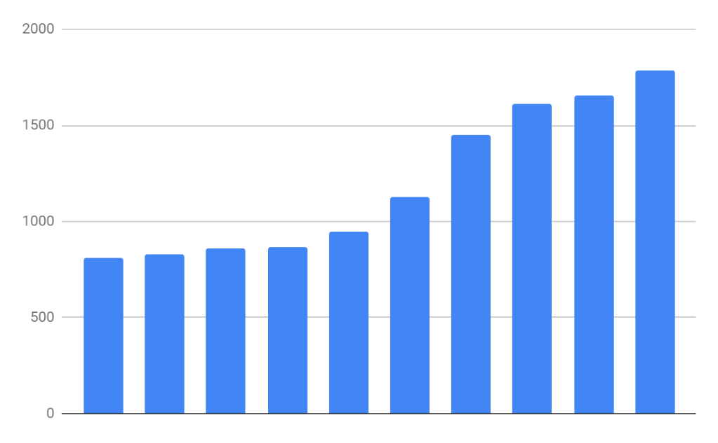
Basic Bar Charts
Rectangles are representative of frequency of term
Word Frequency Matrix
word | freq
Term1 | 0
Term2 | 2
Term3 | 3
… | 5
Term_n | 2

Slide 5
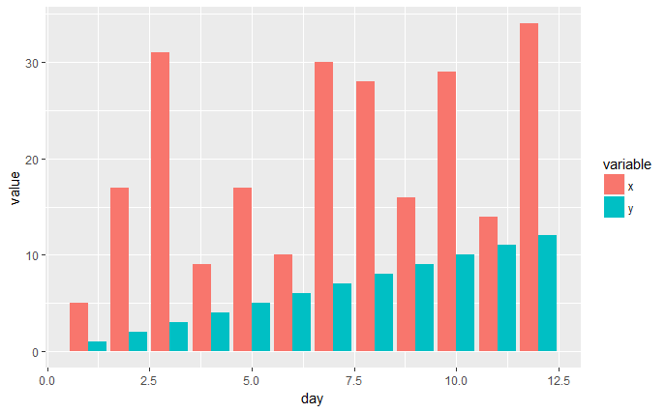
Side by Side Charts
Compare in common words frequency between two groups i.e. speeches of different political parties

Slide 6
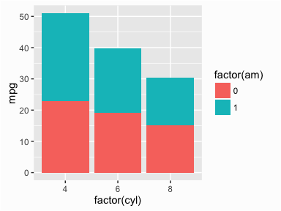
Stacked Bar Charts
Stacked bar charts lets you compare proportion within a category
If you have a category of documents and a word list you can measure the density of terms from the list within the document groups.

Slide 7
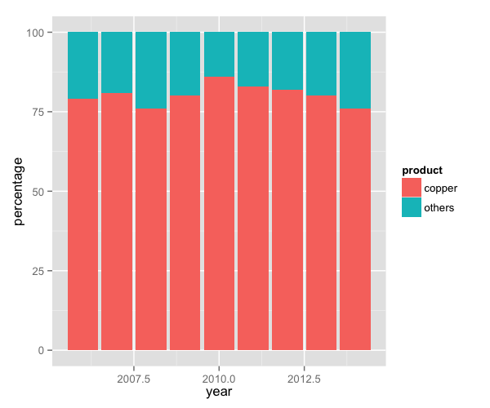
Proportional Stacked Bar Charts
Sometimes you have different length documents so a simple frequency wouldn’t work. Thus the density can be shown as a proportion.

Slide 8
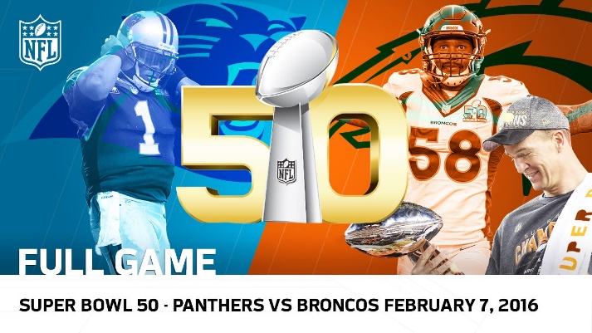
Overall, what frequency distribution should we expect?
Many words in natural language but also a steep decline in actual usage. Follows a predictable pattern.

Slide 9
Top 100 terms
This predictable pattern is called “Zipf’s Law”

Slide 10
Zipf’s Law is observed in human behavior
Population density often falls into this type of distribution
Swiss Cities
UK Cities

Slide 11
Zipf’s Law is observed in business
Many industries become natural monopolies. Without this natural maturing the industry is hyper competitive “Coke vs Pepsi”
Insurance - 2016 Direct Premiums Written ($)
Tech – 2018 US Cloud Compute Mkt Share
https://www.insure.com/car-insurance/largest-auto-insurance-companies-by-market-share.html
https://www.canalys.com/newsroom/cloud-market-share-q4-2018-and-full-year-2018

Slide 12
Zipf’s Law: The frequency of a word is inversely related to its rank in a word frequency matrix.
In language this means we should expect coming words to dominate.
Observation or Word A appears N times
Word B is expected to appear N/2
Word C is expected to appear N/3
Word D is expected to appear N/4
…
…
Term Rank
https://www.worlddata.info/average-income.php

Slide 13
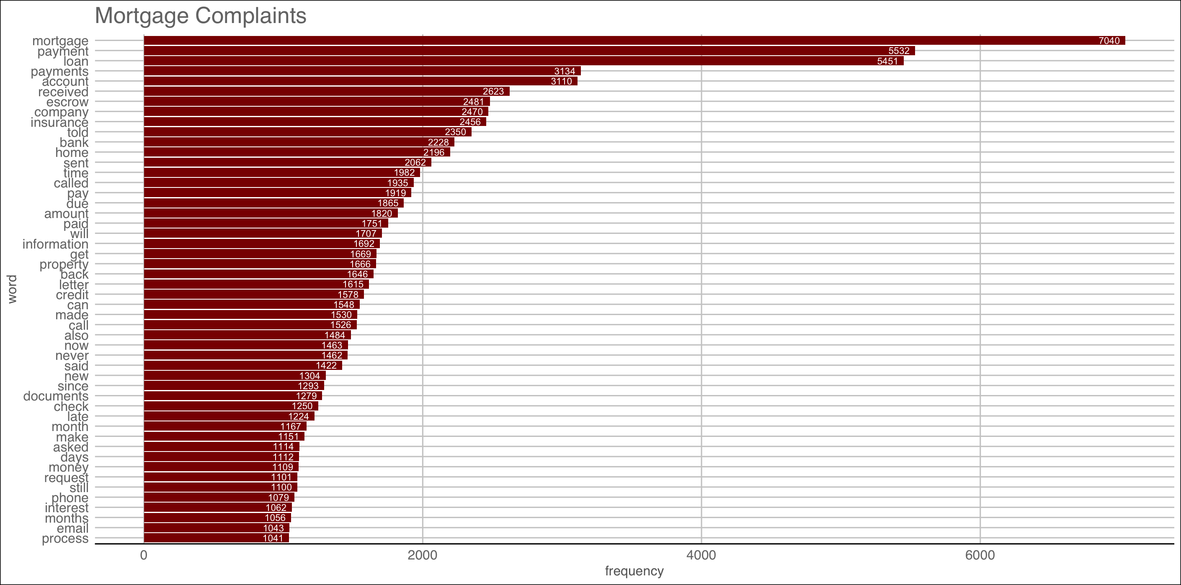
Open B_Frequency_Associations.R
Visualizing the WFM
Brewdog?! Let’s investigate

Slide 14
Word Association
Tuning Parameter: Adjust 0.30 to get the terms that are associated/correlated .30 or more with the unexpected term terms.
# Inspect word associations
associations<-findAssocs(txtDTMa, 'never', 0.30)
Any word that appears at least 30% of the time with “never” in document will be returned.
Word Association uses Pearson correlation but only returns positive values. Thus, terms can only be positively associated. This is because there are so many terms that most everything would be negatively “correlated” in that is appears without the term you’re searching for( actually associated).

Slide 15
Word Association to plot
Changing terms into factors lets ggplot2 order them
# Make a dot plot
assocDF <- data.frame(terms=names(associations[[1]]),
value=unlist(associations))
assocDF$terms <- factor(assocDF $terms, levels= assocDF $terms)
ggplot(assocDF, aes(y=terms)) +
geom_point(aes(x=value), data=assocDF, col='#c00c00') +
theme_gdocs() +
geom_text(aes(x=value,label=value),
colour="red",hjust="inward", vjust ="inward" , size=3)

Slide 16
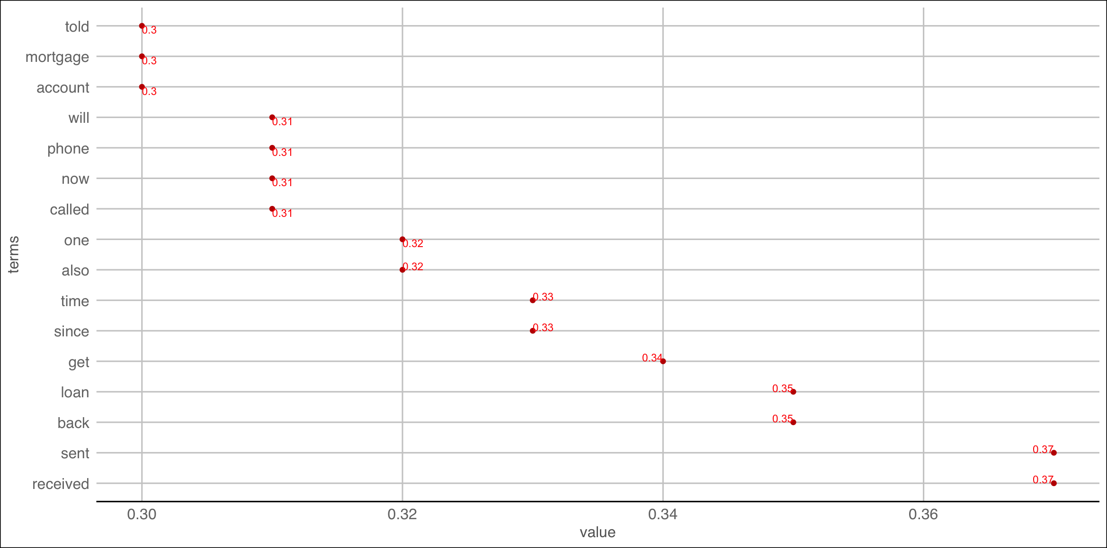

Back to B_Frequency_Associations.R
“received” & “sent” have the highest word association with “never”
grep("never.*received|received.*never", text$Consumer.complaint.narrative)
text$Consumer.complaint.narrative[matches_never_received[3]]

Slide 17

Association is NOT frequency.
“never” appears 929 times
“received” is the most associated term
“received” appears 1252 times. So Received is more frequent but association merely states when “never” appears it is highly correlated with “received”

Slide 18
Dendrograms: Hierarchical Clusters
Which two are most similar? What approximate value would “connect” the two?
Real Rainfall Data
City | Annual Rainfall (in)
Portland | 43.5
Boston | 43.8
New Orleans | 62.7

Slide 19
Dendrograms: Hierarchical Clusters
Rainfall Data as a Dendrogram
63
44
Boston
Portland
New Orleans
Boston & Portland are a cluster at height ~44, losing precision to create the cluster.

Slide 20
Dendrograms: Hierarchical Clusters
Visualizes hierarchical data. For text, the frequency distances are calculated to create the hc object.
Real Rainfall Data
Rainfall Data as a Dendrogram
63
City | Annual Rainfall
Portland | 43.5
Boston | 43.8
New Orleans | 62.7
44
Boston
Portland
New Orleans

Slide 21
Dendrograms: Hierarchical Clusters
Keep in Mind a Dendrogram
Rainfall Data as a Dendrogram
Reduces information much like average is a reduction of many observations’ values
Word clusters emerge often showing related terms/phrases
Term frequency is used to construct the word cluster. Put another way, term A & term B have similar freq. distances & are considered a cluster
63
44
Boston
Portland
New Orleans

Slide 22
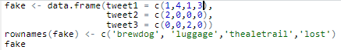
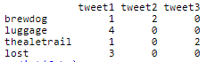
Distance Matrix
The default is to use the Euclidean distance although others i.e. Manhattan can be explored.
Fake TDM

Slide 23

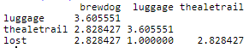
Distance Matrix
The result is a symmetrical matrix of distances (1/2) is blank bc redundant.
Fake TDM

Slide 24
Distance Matrix
Fake TDM
Tweet1: “thealetrail” = 1; “lost” = 3; (3-1) = 2
Tweet2: “thealetrail” = 0; “lost” = 0; (0-0) = 0
Tweet3: “thealetrail” = 2; “lost” = 0; (2-0) = 2
Calculation:
sqrt(2) + sqrt(0) + sqrt(2) = 1.41 + 0 + 1.41 = 2.82

Slide 25
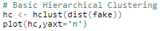
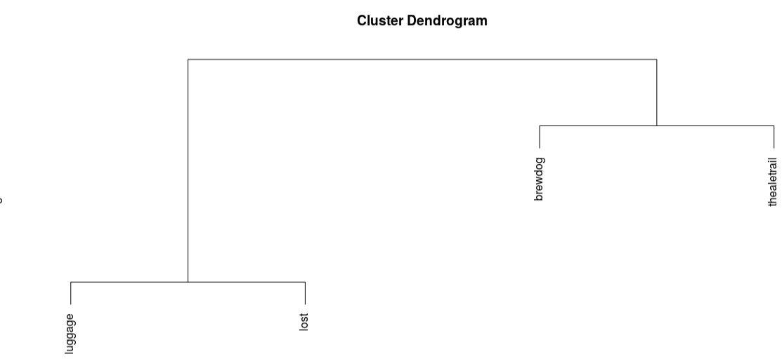
Distance Matrix
Fake TDM
Lost luggage has low distances meaning they are together a lot. Thus lower is smaller distances.

Slide 26
Words as association networks

Slide 27
Networks…for people
Social network analysis is a distinct line of study, but can be applied to word “association”
Tom
Edge
Jim
Node
Sue
Jen

Slide 28
Networks…for words
Social network analysis is a distinct line of study, but can be applied to word “association”
London
Edge
British Airways
Node
Beer
AleTrail

Slide 29
Word Networks…Social Network Analysis
Always hard to interpret, what terms are associated with the initial string at varying degrees of separation. i.e. associations of associations
word_associate(assocText,
match.string = 'brewdog',
stopwords = networkStops,
network.plot = T,
cloud.colors = c('black','darkred'))

Slide 30
Word cloud of Term Associations
Always hard to interpret, what terms are associated with the initial string at varying degrees of separation. i.e. associations of associations
word_associate(assocText,
match.string = 'brewdog',
stopwords = networkStops,
wordcloud = T,
cloud.colors = c('black','darkred'))

Slide 31

Open C_Dendrograms_WordNetworks.R
Learning Objective
Use Dendrogram to identify phrases
Use Word networks to see second and third order word connections.
Stable Diffusion, mdjrney-v4:
word network, data science, natural language processing, , Detailed and Intricate, 4K,, Synthwave, Dynamic Lighting, Artstation

Slide 32
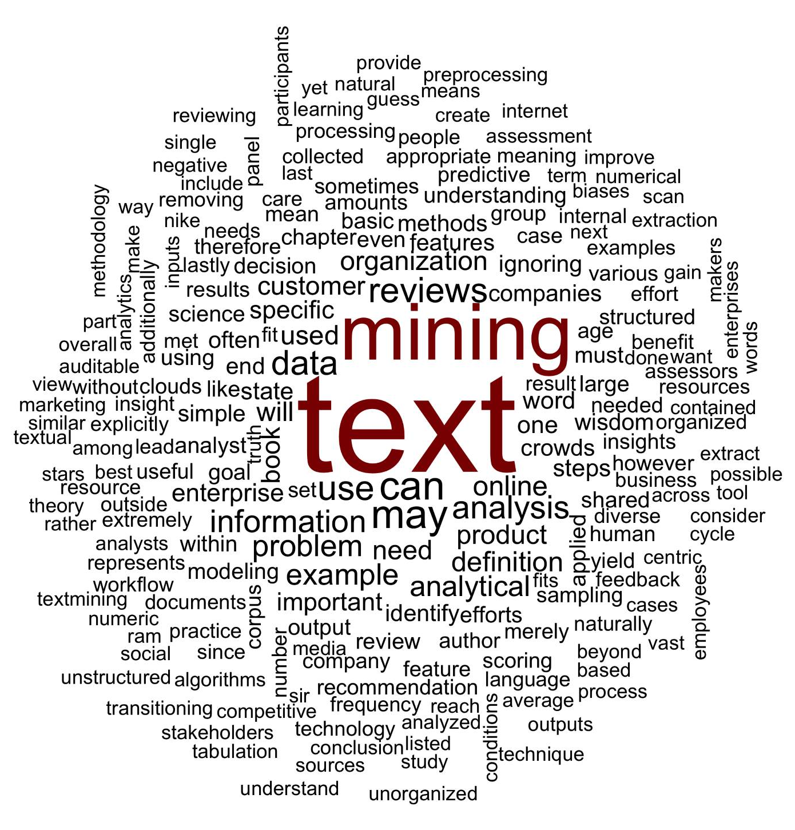
What is a word cloud?
Maligned and overused, a word cloud is a frequency visualization.

Slide 33
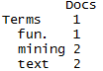
Unigram Tokenization
Thus far, we have performed unigram tokenization of terms.
“Text mining is so fun. So do text mining!
*with common stopwords

Slide 34
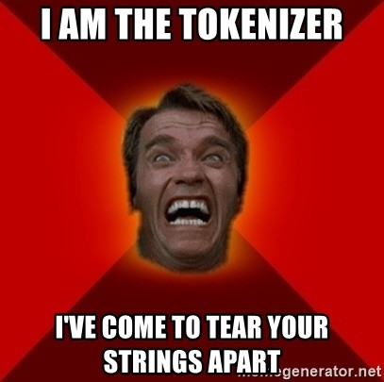
Changing Tokenization Schema
First create a function defining tokenization then add as a control parameter to TDM or DTM.
Within R
#bigram token maker
bigramTokens <-function(x)
unlist(lapply(NLP::ngrams(words(x), 2), paste, collapse = " "), use.names = FALSE)
wineTDM<-TermDocumentMatrix(txtCorpus, control=list(tokenize=bigramTokens))

Slide 35
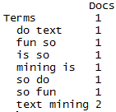
Tokenization is the process of chopping up a string into predefined units called tokens.
Now the TDM has two terms instead of one.
“Text mining is so fun. So do text mining!
#bigram token maker
bigramTokens <-function(x)
unlist(lapply(NLP::ngrams(words(x), 2), paste, collapse = " "), use.names = FALSE)
wineTDM<-TermDocumentMatrix(txtCorpus, control=list(tokenize=bigramTokens))

Slide 36
To make a wordcloud start with a WFM
# Get Row Sums & organize
wineTDMv <- sort(rowSums(wineTDMm), decreasing = TRUE)
wineDF <- data.frame(word = names(wineTDMv), freq = wineTDMv)
Document Term Matrix
Word Freq Matrix
 | Term1 | Term2 | Term3 | Term4 | … | Term_n
Doc1 | 0 | 0 | 0 | 0 | 0 | 0
Doc2 | 1 | 1 | 0 | 0 | 0 | 0
Doc3 | 1 | 0 | 0 | 2 | 0 | 0
… | 0 | 0 | 3 | 0 | 1 | 1
Doc_n | 0 | 0 | 0 | 1 | 1 | 0
word | freq
Term1 | 2
Term2 | 1
Term3 | 3
Term4 | 3
Term … | 2
Term_n | 1

Slide 37
Then sort it decreasing = TRUE
# Get Row Sums & organize
wineTDMv <- sort(rowSums(wineTDMm), decreasing = TRUE)
wineDF <- data.frame(word = names(wineTDMv), freq = wineTDMv)
word | freq
Term1 | 2
Term2 | 1
Term3 | 3
Term4 | 3
Term … | 2
Term_n | 1
word | freq
Term3 | 3
Term4 | 3
Term1 | 2
Term_... | 2
Term2 | 1
Term_n | 1

Slide 38
Setting a pre-made color palette for your WC
# Review all Pallettes
display.brewer.all()
# Choose a color & drop light ones
pal <- brewer.pal(8, "Blues")
pal <- pal[-(1:2)]

Slide 39
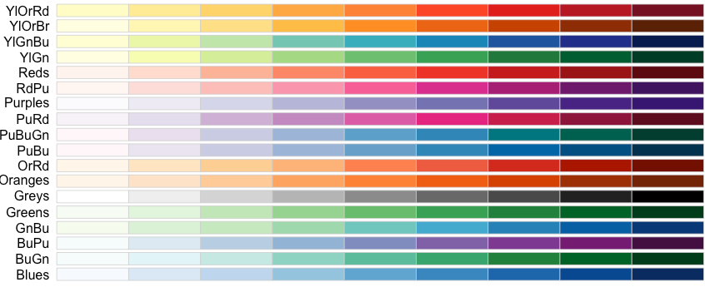
Setting a pre-made color palette for your WC
In R…

Slide 40
Let’s practice!
D_SimpleWordCloud.R

Slide 41
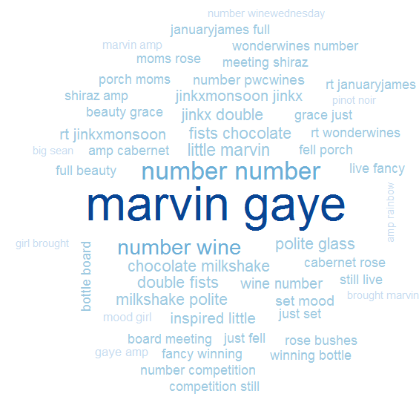
D_SimpleWordCloud.R
Bigram Tokenization has captured “marvin gaye”
A word cloud is a frequency visualization. The larger the term (or bigram here) the more frequent the term.
You may get warnings if certain tokens are to large to be plotted in the graphics device.
Be careful with your preprocessing steps!

Slide 42
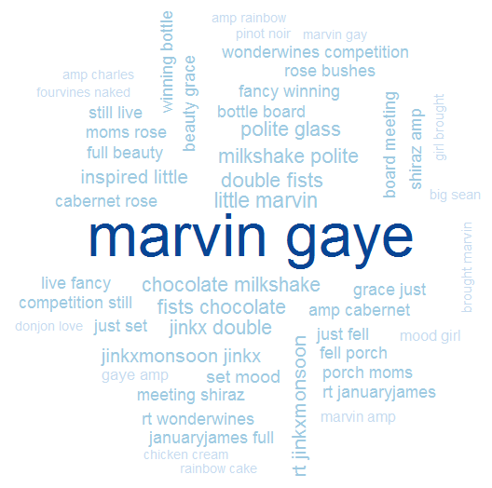
D_SimpleWordCloud.R
In qdaap the function replace_symbol() changes numeric with the generic string “number” so be careful with your preprocessing steps!

Slide 43
Another WC package
E_d3_wordcloud.R

Slide 44
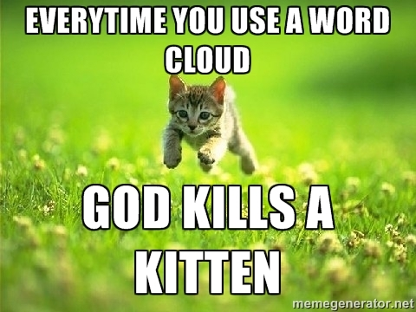
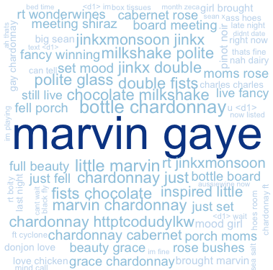
WCs are boring with a single corpus.
Single Corpus
wordcloud( )

Slide 45
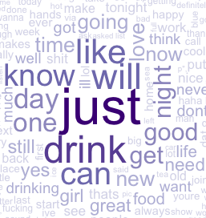
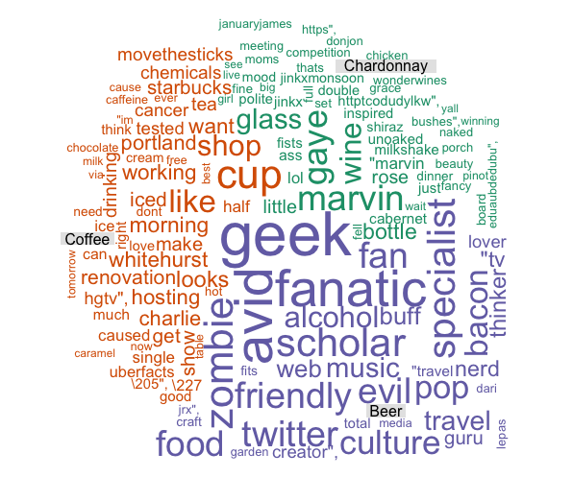
With 2+ Corpora, WCs are more insightful
Multiple Corpora
comparison.cloud( )
commonality.cloud( )
comparison.cloud( )
comparison.cloud( )

Slide 46
Dealing with many text files is tricky.
There are many options including custom functions lapply and here is a loop so we can learn step by step.
chardonnay <- 'chardonnay.csv'
coffee <- 'coffee.csv'
txtFiles <- c(chardonnay, coffee)
# Topic names
topicNames <- c('chardonnay','coffee’)
# Read in the files
for (i in 1:length(txtFiles)){
assign(topicNames[i], read.csv(txtFiles[i]))
cat(paste('read completed:',txtFiles[i],'\n'))
}
Using a loop each file is an individual object while lapply would return a list with two elements.

Slide 47
Dealing with many text files is tricky.
Option 2 – not in our script but is more concise code.
# Read in multiple files as individuals; list.files(); dir()
txtFiles <- c('chardonnay.csv','coffee.csv','beer.csv')
# Read them into a single list with individual elements
allDocs <- lapply(txtFiles,read.csv)
With lapply functions each document is a list element of a single object.

Slide 48

Manipulating multiple corpora
Combined/Collapsed
into a 2 document corpus
CorpusA – 1000 Tweets
Clean & Collapse
CorpusB – 1000 Tweets
Clean & Collapse

Slide 49
The new WC will examine inner and disjoins

Slide 50
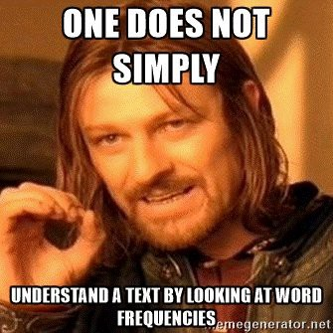
Lets make some improved word clouds
F_CommonalityCloud.R

Slide 51
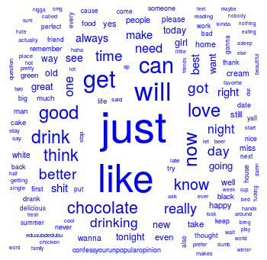
What tokens are in common?

Slide 52
Introducing TF-IDF Term Frequency Inverse Document Frequency
So far, you have used simple term frequency to identify informative words. Chardonnay is highly frequent in the tweets, but since it appears in all documents it isn’t informative.
Term frequency * inverse-document-frequency
If a term appears often, it must be important to the corpus.
But, if a term appear in many documents, it can’t be distinctive or informative
Increasing
importance
Offsetting
importance

Slide 53
The TF of TF-IDF
Term Frequency isn’t just a count. It is normalized because unique terms will naturally increase the longer the document.
Term frequency = Term Occurrence / total unique terms in a document

Slide 54
Inverse Document Frequency
IDF is the natural log of total documents divided by the number of documents containing a specific token.
Inverse Document Frequency =
log(total documents in corpus) / number of documents with term in it
Notes:
Pg 101 in book has explanation

Slide 55
Original Term Frequency
In 1000 documents suppose token “coffee” occurs 1000 times
TF = 1000

Slide 56
TF-IDF Simple Example
Coffee TF = 1000 will look VERY important but TFIDF = 0.69 will correctly have minimal impact for analysis.
In 1000 documents each of 10 words suppose token “coffee” occurs 1000 times
TF = 1000 / 10 #normalizes to doc length
TF = 100
IDF = log(1000) / 1000
IDF = 6.90 /1000
IDF = .0069
*Caveat – the results in R are normalized/scaled by default.
TF-IDF = 100 * .0069
TF-IDF = .69

Slide 57
Applying TF-IDF to a DTM/TDM
You can pass in more than one control parameter like tokenization & weighting.
# Control Paramter
ctrl <- list(weighting = weightTfIdf)
# Apply in TDM/DTM construction
drinkTDM <- TermDocumentMatrix(allDrinks, control = ctrl)
# Change to a simple matrix
drinkTDMm <- as.matrix(drinkTDM)

Slide 58
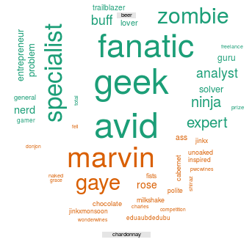
What tokens are in not in common (disjoint)?

Slide 59
What about disjoint tokens?
G_ComparisonCloud.R

Slide 60
What about proportional similarities?
The problem is that if corpusA has 1 instance & corpus has 1000 they appear as shared.

Slide 61
Let’s make some pyramids

Slide 62
Steps for a pyramid plot…collapse
Combined/Collapsed
into a 2 document corpus
CorpusA – 1000 Tweets
Clean & Collapse
CorpusB – 1000 Tweets
Clean & Collapse

Slide 63
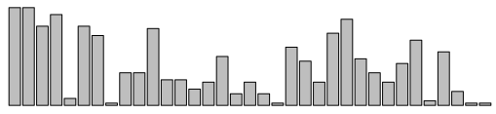
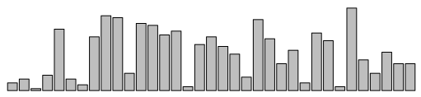
Steps for a pyramid plot…ID common tokens & frequency

Slide 64
Build a “pyramid plot” of frequencies
termA
termB
…
TermN

Slide 65

Open ﻿H_Pyramid_plots.R

